Slide 1

Data Analytics Project Using SQL |
Walmart Dataset
By
Karan V Menon

Slide 2


Introduction
This project is a self-initiated endeavor that utilizes skills in SQL for data analysis. The data used is sourced from Kaggle sales forecasting competition. Thank you for viewing, and I welcome any suggestions for improvement

Slide 3
About The Dataset
The datasets provided is as a csv file. The entire dataset consists of 17 columns and 1000 rows as follows:
1. Invoice ID, 2. Branch, 3. City, 4. Customer type, 5. Gender, 6. Product line, 7. Unit Price, 8. Quantity, 9. Tax 5%, 10. Total, 11. Date, 12. Time, 13. Payment, 14. cogs, 15. gross margin percentage, 16. gross income, 17. Rating

Slide 4
Exploratory Data Analysis
Number of Distinct Cities

Slide 5

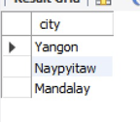
General Analysis
Result:
Number of Distinct Cities
This query identifies the number of distinct cities in the dataset
SELECT DISTINCT city FROM sales;

Slide 6
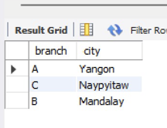
General Analysis
Result:
Identify the city in each branch
This query identifies distinct city in each branch
SELECT DISTINCT branch, city FROM sales;

Slide 7
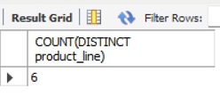
Product Analysis
Result:
Number of distinct product lines
This query counts the number of distinct product line in the dataset
SELECT COUNT(DISTINCT product_line) FROM sales;

Slide 8
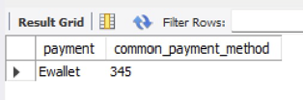
Product Analysis
Result:
Most common payment method
This query identifies the most common payment method
SELECT payment, COUNT(payment) AS common_payment_method FROM sales GROUP BY payment ORDER BY common_payment_method DESC LIMIT 1;

Slide 9
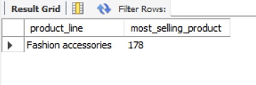
Product Analysis
Result:
Most selling product line
This query identifies the most selling product line
SELECT product_line, count(product_Line) AS most_selling_productFROM sales GROUP BY product_line ORDER BY most_selling_product DESC LIMIT 1;

Slide 10
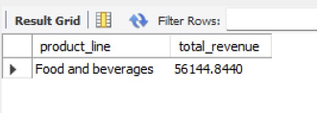
Product Analysis
Result:
Product line generates highest revenue
This query identifies the product line which generates highest revenue
SELECT product_line, SUM(total) AS total_revenueFROM sales GROUP BY product_line ORDER BY total_revenue DESC LIMIT 1;

Slide 11
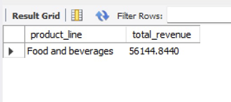
Product Analysis
Result:
City which generates highest revenue
This query identifies the city which generates highest revenue
SELECT city, SUM(total) AS total_revenueFROM sales GROUP BY city ORDER BY total_revenue DESC LIMIT 1;

Slide 12
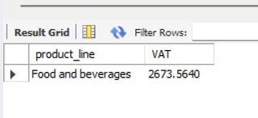
Product Analysis
Result:
Product line generates highest VAT
This query identifies the product line which generates highest VAT
SELECT product_line, SUM(vat) as VAT FROM sales GROUP BY product_line ORDER BY VAT DESC LIMIT 1;

Slide 13
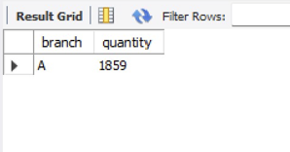
Product Analysis
Result:
Branch sold more products than Average products sold
This query identifies the branch which sold more products than Average products sold
SELECT branch, SUM(quantity) AS quantityFROM sales GROUP BY branch HAVING SUM(quantity) > AVG(quantity) ORDER BY quantity DESC LIMIT 1;

Slide 14
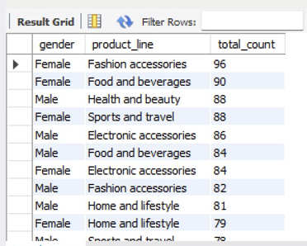
Product Analysis
Result:
Most common product line by gender
This query identifies the most common product line by gender
SELECT gender, product_line, COUNT(gender) total_count FROM sales GROUP BY gender, product_line ORDER BY total_count DESC;

Slide 15
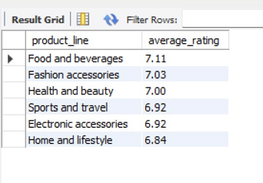
Product Analysis
Result:
Average rating of each product line
This query identifies the average rating of each product line
SELECT product_line, ROUND(AVG(rating),2) average_ratingFROM sales GROUP BY product_line ORDER BY average_rating DESC;

Slide 16

Identified distinct product lines.
Identified the most common payment method
Identified most selling product line.
Identified the product line which generated highest revenue.
Identified the city which generate highest revenue.
Identified the product line incurred highest VAT
Identified the branch which sold more product than average products sold.
Identified the most popular product line by gender.
Identified the average rating of each product line.
Product Insights

Slide 17
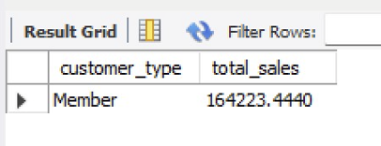
Sales Analysis
Result:
Customer type that generates highest revenue
This query identifies the type of customer who generates highest revenue
SELECT customer_type, SUM(total) AS total_salesFROM sales GROUP BY customer_type ORDER BY total_sales DESC LIMIT 1;

Slide 18
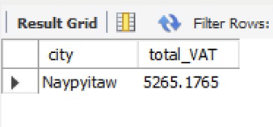
Sales Analysis
Result:
City having largest tax percent/ VAT
This query identifies the city having largest tax percent/VAT?
SELECT city, SUM(VAT) AS total_VAT FROM sales GROUP BY city ORDER BY total_VAT DESC LIMIT 1;

Slide 19
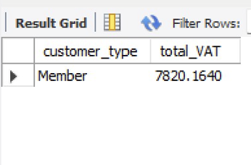
Sales Analysis
Result:
Customer pays most VAT
This query identifies the type of customer who pays most VAT
SELECT customer_type, SUM(VAT) AS total_VATFROM sales GROUP BY customer_type ORDER BY total_VAT DESC LIMIT 1;

Slide 20

Sales Insights
Identified the type of customer that generates highest revenue.
Identified the city having largest VAT
Identified the customer type who pays most VAT.

Slide 21
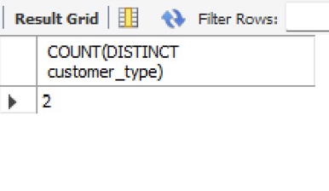
Customer Analysis
Result:
Number of unique type of customers
This query identifies the number of customer types
SELECT COUNT(DISTINCT customer_type) FROM sales;

Slide 22
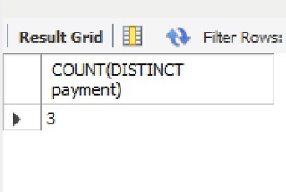
Customer Analysis
Result:
Number of unique payments methods
This query identifies the number of unique payment methods
SELECT COUNT(DISTINCT payment) FROM sales;

Slide 23
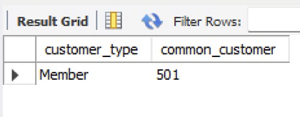
Customer Analysis
Result:
Most common customer type
This query identifies the most common customer type
SELECT customer_type, COUNT(customer_type) AS common_customerFROM sales GROUP BY customer_type ORDER BY common_customer DESC LIMIT 1;

Slide 24
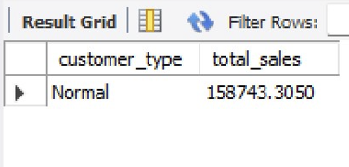
Customer Analysis
Result:
Customer type who buys the most
This query identifies the customer type who buys the most
SELECT customer_type, SUM(total) as total_salesFROM sales GROUP BY customer_type ORDER BY total_sales LIMIT 1;SELECT customer_type, COUNT(*) AS most_buyerFROM sales GROUP BY customer_type ORDER BY most_buyer DESC LIMIT 1;

Slide 25
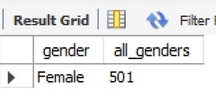
Customer Analysis
Result:
Gender of most of the customers
This query identifies the gender of most of the customer
SELECT gender, COUNT(*) AS all_genders FROM sales GROUP BY gender ORDER BY all_genders DESC LIMIT 1;

Slide 26
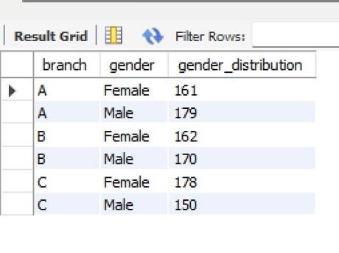
Customer Analysis
Result:
Gender distribution per branch
This query identifies the gender distribution per branch
SELECT branch, gender, COUNT(gender) AS gender_distributionFROM sales GROUP BY branch, gender ORDER BY branch;

Slide 27

Customer Insights
Identified the number of unique customers
Identified the number of unique payment methods
Identified the most common type of customers.
Identified which customer purchased the most
Identified the most common gender.
Identified the gender distribution per branch

Slide 28
Recommendations to increase Business & Profit
Delivery
Marketing
Products
Threat & Solution
Make the social media marketing more aggressive it tends to generates for successful purchase
Focus on more on the city that generates more income.
Competitors are focusing on cities where we are not doing good. Better brand positioning, better discounts can helps a lot in solving this issue.
Focus on other cities which has huge potential

Slide 29


Thank You!
-From
Karan V Menon
I’m excited to continue growing and taking on more challenges that blend analytics with business understanding! Feel free to add any suggestions or recommendations.

